Slide 1


Chaussette : A Symbolic Verification of Bitcoin Script
Vincent Jacquot & Benoit Donnet (University of Liège)
This work is supported by the CyberExcellence project funded by the Walloon Region, under number 2110186

Slide 2
Key points
Two attacks on Bitcoin:
Attack on Non-Standard Scripts
Front-Running Attack
55 ₿ (2.6M € worth) could have been stolen
between 2009-01-03 and 2023-02-04.
1,304 ₿ are estimated to be at risk.

Slide 3
Agenda
Attack on Non-Standard Scripts
Background: Anatomy and verification of a Bitcoin transaction
Chaussette: A symbolic execution tool
Front-Running Attack
Background: Journey of a Bitcoin transaction
Sniff, craft, outbid
Quantification
Q&A

Slide 4
Attack on Scripts
Background

Slide 5
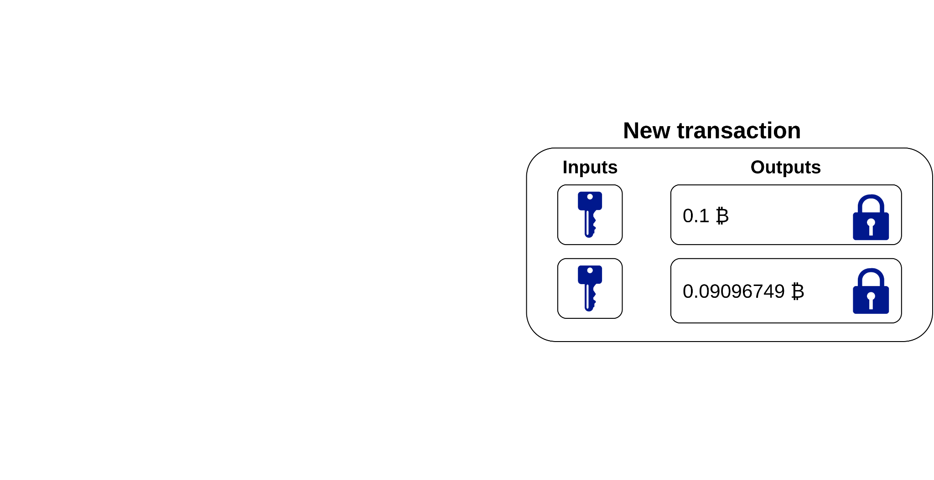
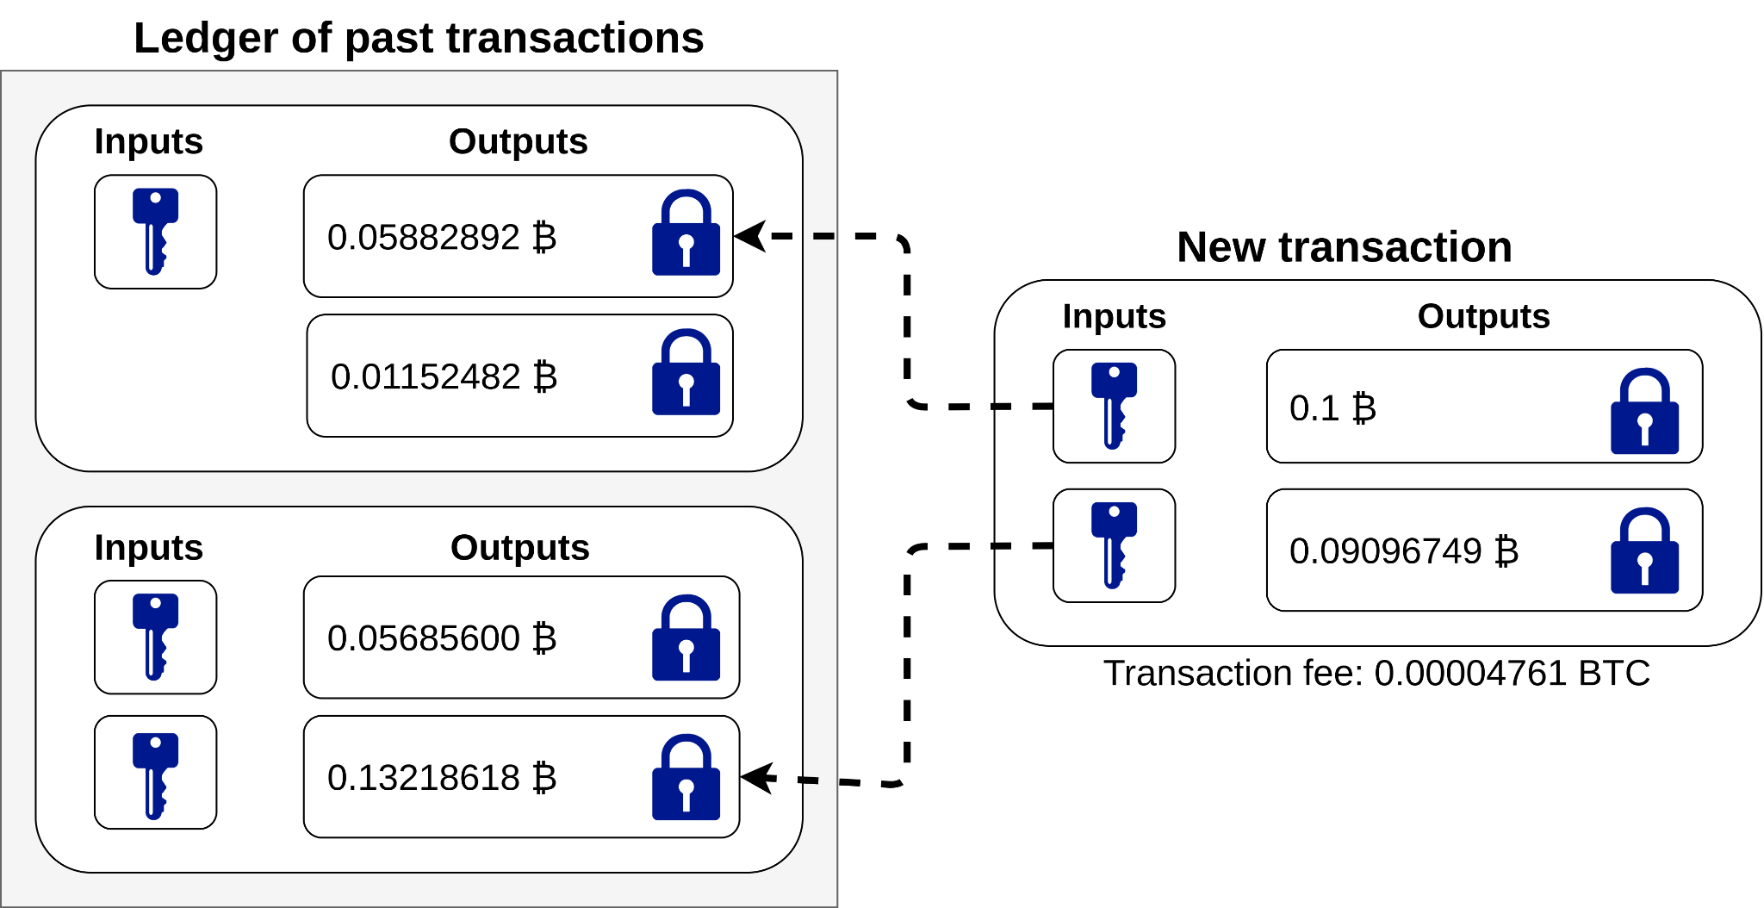
Anatomy of a transaction
Bitcoin is a protocol that defines a decentralized digital currency: the bitcoin (₿)
A Btc transaction is composed of outputs and inputs.
Outputs
store the money;
define the conditions for spending the money.
Inputs
spend outputs;
carry the proof of ownership.

Slide 6
Verification of a transaction
5
3
2Dup
+
8
Equal
Verify
-
2
==
Input script
Output script
Bitcoin outputs and inputs both contain a script.
3
8
Written in Script
A stack-based language
No jump instruction
Bitcoin defines secure standard scripts.
During the verification of a transaction, both scripts are
extracted,
concatenated,
and executed.
The top stack value is expected to be “True”.
5
8
3
2
5
2
1
STACK

Slide 7
Attack on Scripts
Chaussette

Slide 8
Chaussette: High-level process
parses the output script;
executes output scripts on symbols
returns scripts’ output as a function in terms of these symbolic inputs.
uses a SMT solver to find concrete values for which the top item is True.
Chaussette
Parsing
Symbolic Execution
top = (x+y == 8)
Z3
+
8
==
(x=8, y=0)
Output script
Are there values for which top != 0 ?

Slide 9
Chaussette: Parsing
0
>
If
Hash
160
96d0…
==
Else
Size
4
<
EndIf
Purpose: build a control flow graph
0
>
If
Block 0
Hash
160
96d0…
==
Size
4
<
Block 1
Block 2
EndIf
Block 3

Slide 10
Chaussette: Symbolic Execution
0
>
If
Path constraints : [v₁ > 0]
Path constraints: [v₁ ≤ 0]
Block 0
Hash
160
96d0…
==
Size
4
<
Block 1
Block 2
The entry block is executed
If (v₁ > 0)
Then 1
Else 0
0
a. New symbols are generated on the fly
b. Path constraints and stack state passed to the children blocks.
STACK

Slide 11
Chaussette: Symbolic Execution
0
>
If
Path constraints : [v₁ > 0]
Path constraints: [v₁ ≤ 0]
Block 0
Hash
160
96d0…
==
Size
4
<
Block 1
Block 2
Expression A
Expr. B
STACK
Expr. C
STACK
2. Children blocks are executed
in depth-first search,
and if all parents have run.

Slide 12
Chaussette: Symbolic Execution
0
>
If
Path constraints : [v₁ > 0]
Path constraints: [v₁ ≤ 0]
Block 0
Hash
160
96d0…
==
Size
4
<
Path constraints: [v₁ > 0 || v₁ ≤ 0]
3. Whenever a child block has multiple parents, we need to reconcile
the path constraints,
the stacks.
Block 1
Block 2
EndIf
Expression A
Expr. B
Block 3
STACK
Expr. C
STACK
If (v₁ > 0),
Then ( Expression A),
Else (Expression B)
The top stack element is thus:

Slide 13
Front-running Attack
Background & Attack

Slide 14
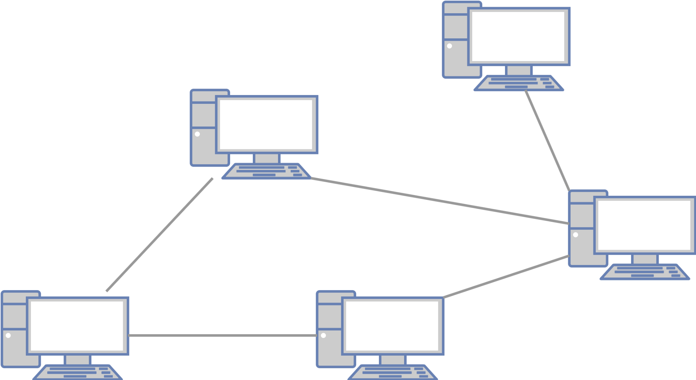
Journey of a Bitcoin transaction
New transactions are broadcast to the network.
And wait in the mempool.
A random node selects the transactions in the mempool that will be included into the ledger.
The transactions’ fees are rewarded to that node.

Slide 15
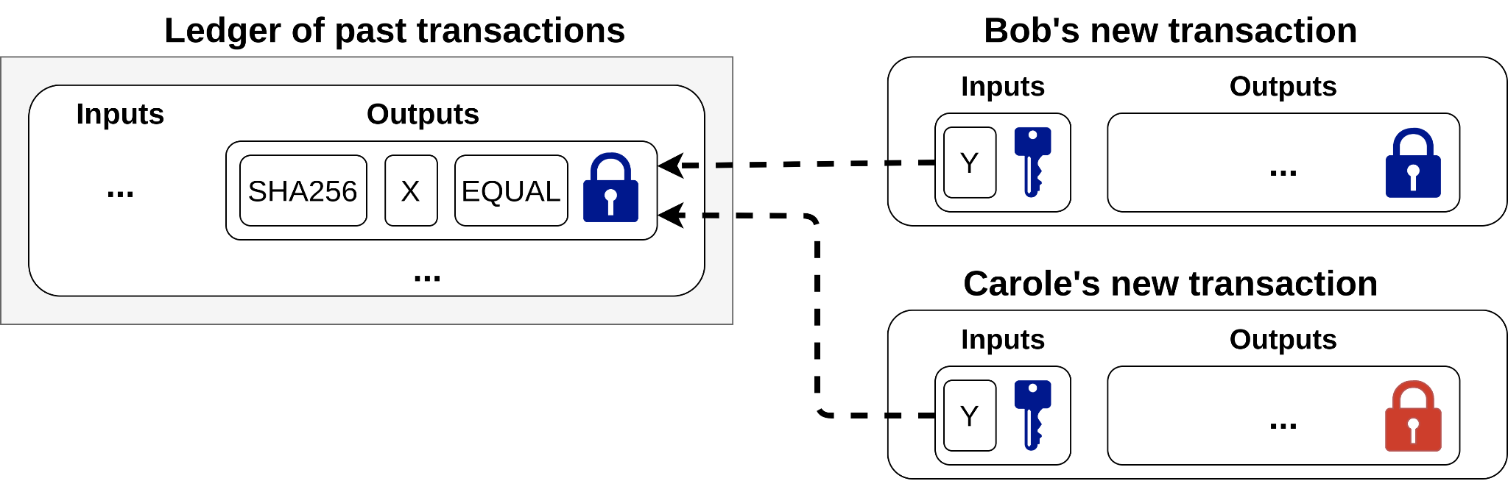
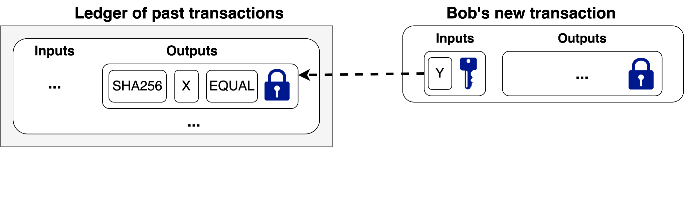
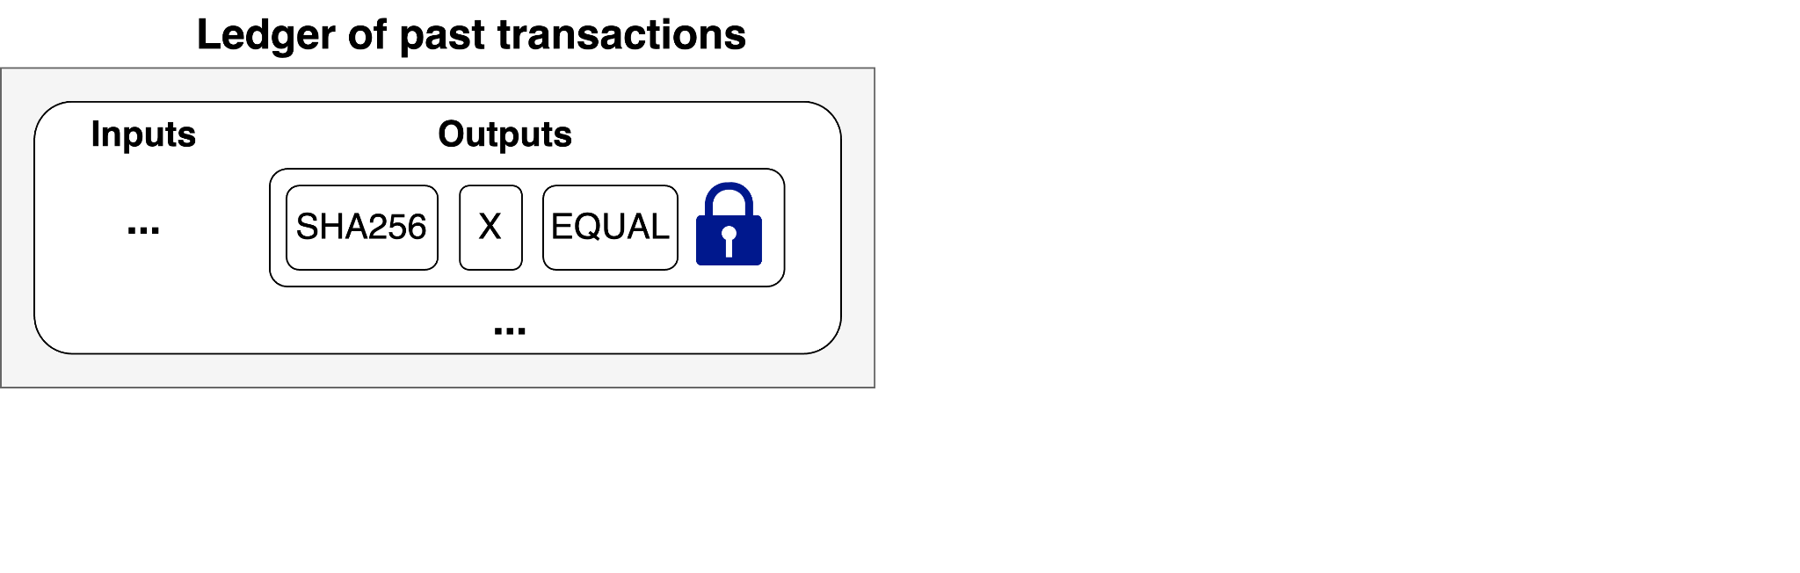
Sniff, Craft, Outbid
All an attacker needs is to
sniff the mempool,
craft a similar transaction,
but with a different output address,
outbid the initial transaction with a higher transaction fee.

Slide 16
Quantification
Chaussette

Slide 17
Chaussette
Blockchain parsed
from block 0
to 775,000 (published on February 4th, 2023).
Nearly 4M non-standard scripts found.
Grouped in 780 patterns
Over the 769 patterns Chaussette manages to analyse within 30 seconds
176 are correctly tagged as unsafe (TP)
588 are correctly tagged as safe (TN)
3 are incorrectly tagged as unsafe (FP)
2 are incorrectly tagged as safe (FN)
Chaussette’s recall is 0.9888 and precision is 0.9832

Slide 18
Attacks
Symbolic execution attacks:
200k scripts were vulnerable
2 ₿ could have been stolen
Front-running attacks:
153k scripts were vulnerable
53 ₿ could have been stolen
Currently: most of the analyzed vulnerable scripts’ funds have been moved to safe outputs.
However, the risk remains unknown for 16.4M unspent outputs (witness_scripthash and scripthash)
Whose spending conditions are not known.
Storing 5.46M ₿
Over all outputs we’ve parsed (641.9M), 2.39 · 10⁻⁴ were vulnerable to front-running attacks.
Assuming the same ratio holds for unanalysed scripts,
3917 scripts could be vulnerable
1304 ₿ could be stolen in the future

Slide 19
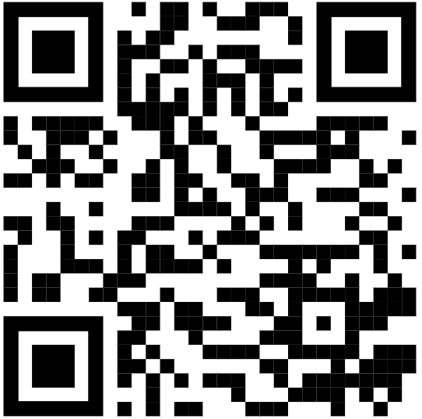
To go further
Check out my paper for more on
Chaussette’s implementation,
the attacks,
a discussion around securing vulnerable scripts,
and more.
Check out Chaussettes’s implementation at
https://gitlab.uliege.be/bitcoin
or ask access to the DB of analysed scripts.

